Slide 1
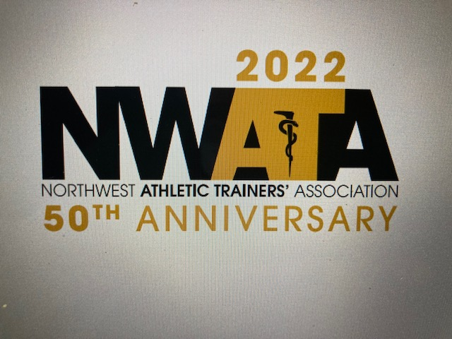

Slide 2
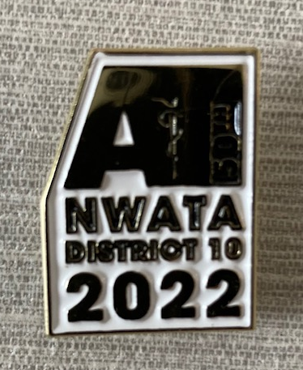

Slide 3
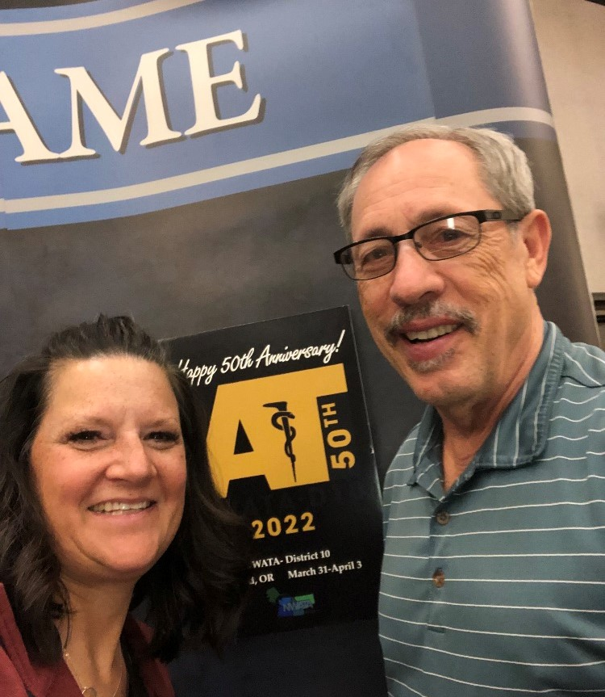
Cari Wood-NWATA 50th Anniversary Chair

Slide 4
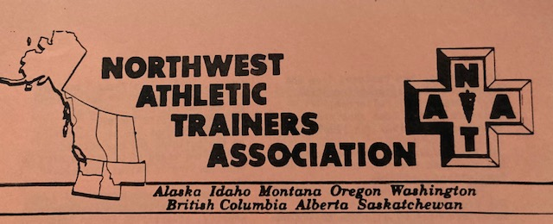
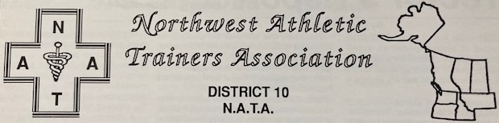
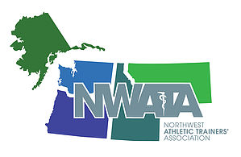
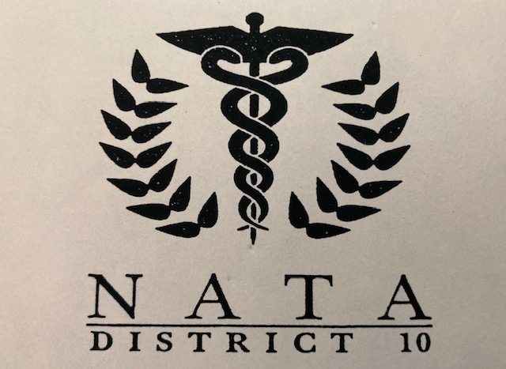
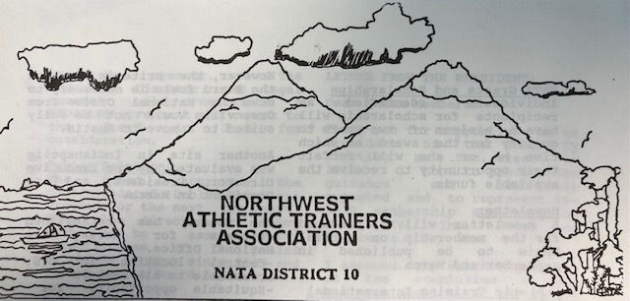
50th Anniversary of the Northwest Athletic Trainers’ Association

Slide 5
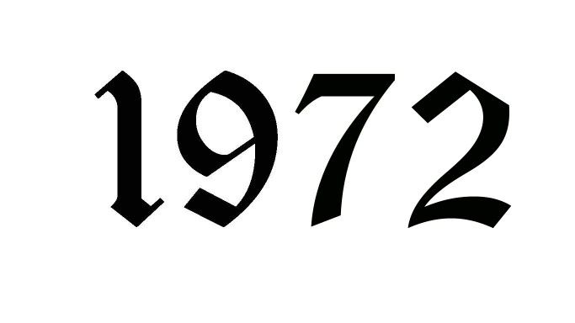

Slide 6
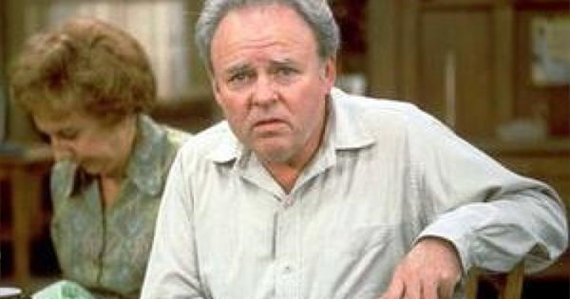
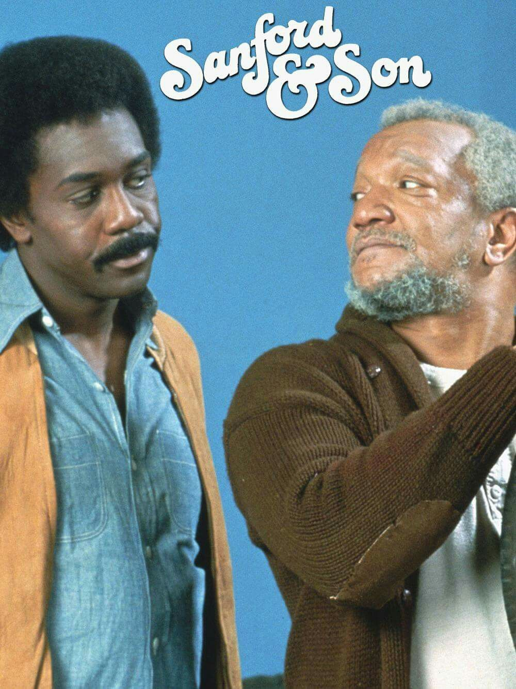
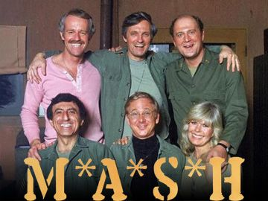
Top TV shows

Slide 7

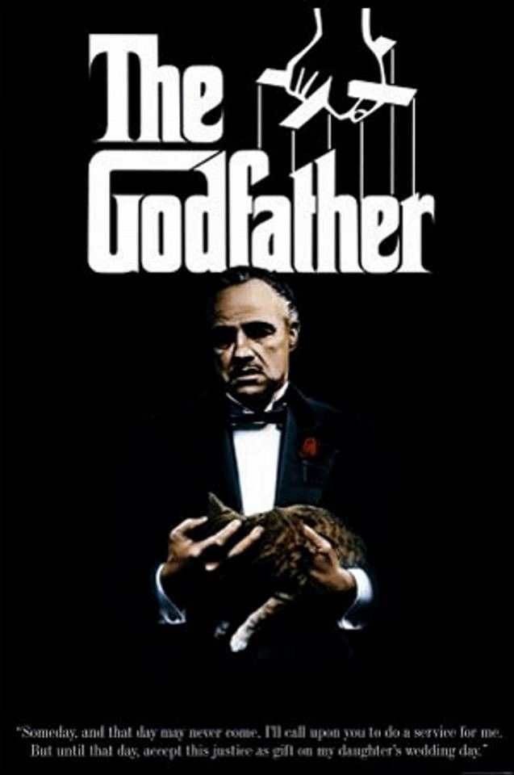

Top Movies

Slide 8
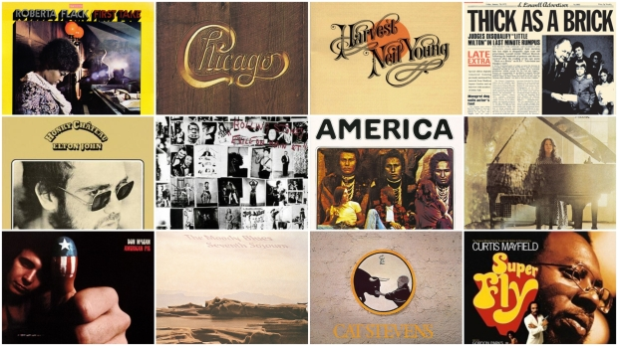
Top selling albums

Slide 9
1972 Facts
Richard Nixon was President Average home price $27,550
Atari was introduced Average new car $ 3,500
Email was introduced Average income $11,800
Gallon of gas 52 cents Loaf of bread 25 cents
Postage stamp 8 cents Gallon of milk $ 1.35
NWATA members 20

Slide 10
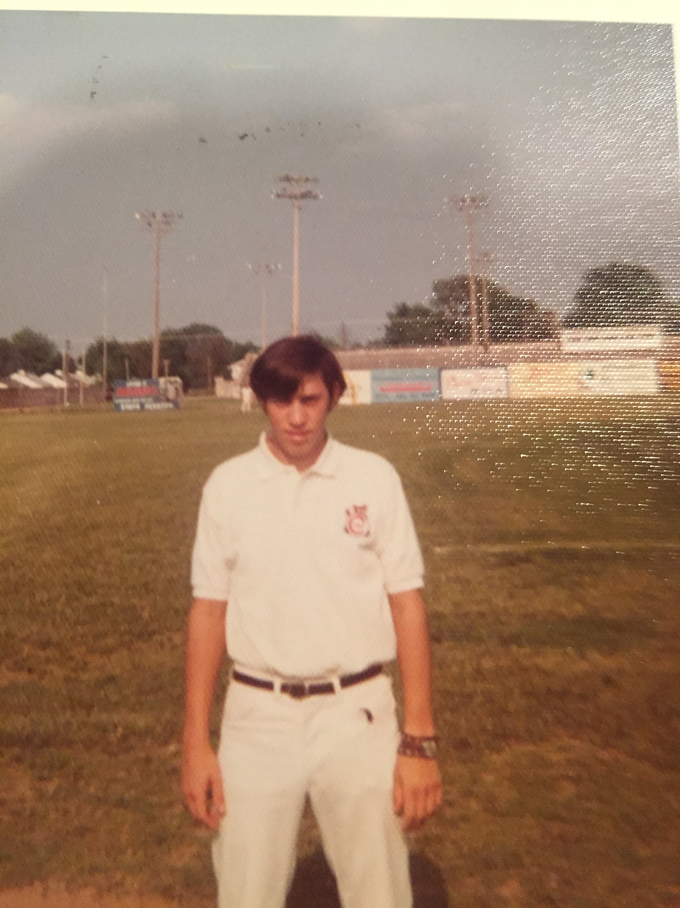
This was me as minor league athletic trainer in for the Quincy, Ill Cubs in 1972 (I still have the shirt)

Slide 11
Time Line
First NATA Convention and formation of geographical Districts
District 10 at that time was all of the Canadian Providences
Washington, Oregon and Alaska were part of District 8 along with
California, Hawaii and Nevada
Idaho and Montana were in District 7 with Wyoming,
Colorado, Arizona, New Mexico and Utah

Slide 12
Time Line (con’t)
  Proposal made to NATA BOD for District Reorganization-made by Dick
  Vandervoort who was the Director of District 8 and WSU Head Athletic
  Trainer
  1972 * NATA Approves Restructuring D-10 from Canadian Providences only to
    Washington, Oregon, Idaho, Montana, Alaska, Saskatchewan, BC & Alberta
    * First District 10 meeting and elections held
    * Sherry Kosek-Babagian (U of W) first female to take and pass NATA BOC exam.

Slide 13
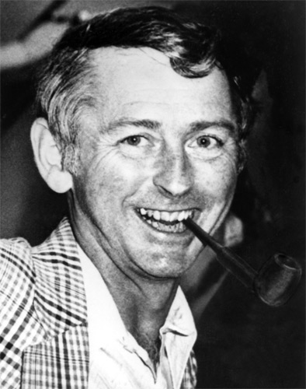
Realignment in 1971
Dick Vandervoort, head athletic Trainer
at WSU was the Director of District 8.
He was charged with reorganization of
the original Districts to increase com-
munication and due to challenges with
geographical boundaries

Slide 14
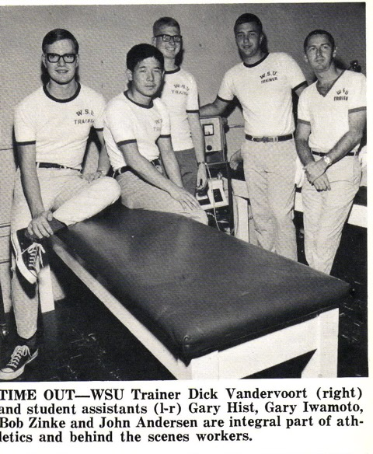

Slide 15
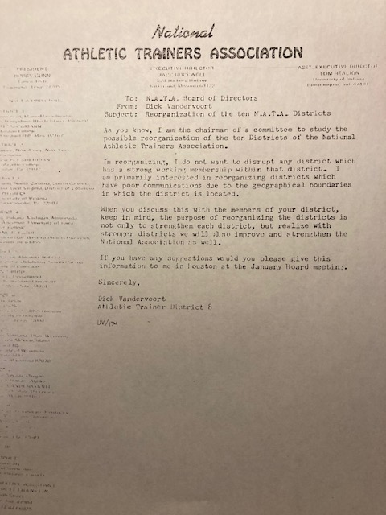

Slide 16
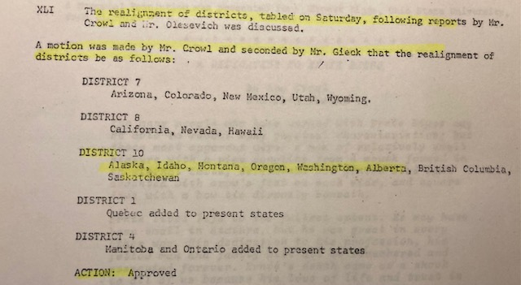
January, 26, ,1972 NATA BOD Meeting at the
O-Hare Inn in Chicago. Realignment approval and the Pacific Coast Athletic Trainers’ Association was formed

Slide 17
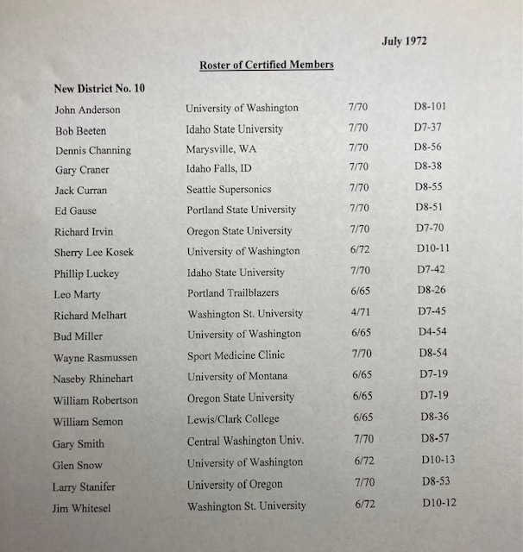

Slide 18
The first District Meeting was held in Eugene, OR on July 23, 1972 at the Black Angus Inn, prior to the American Academy of Orthopedic Surgeons Sports Medicine Meeting
Primary function was to elect officers
10 members were present, voting members unable to attend the meeting were provided mail ballots, a total of 19 ballots were cast.

Slide 19
The First “10”
(Attendees’ at the first meeting)
John Anderson – University of Washington, Assistant Athletic Trainer
Wayne Rasmussen – The Seattle Sports Medicine Clinic
*Dick Irvin – Oregon State University, Program Director
Sherry Kosek Babagian – U of W Physical Therapist/Assistant Athletic Trainer
Dick Melhart-Washington State University, Head Athletic Trainer
* Bud Miller- University of Washington, Head Athletic Trainer
* Bill Robertson- Oregon State University, Head Athletic Trainer
* Bill Semon- Lewis & Clark College-Head Athletic Trainer
Gary Smith-Central Washington University, Head Athletic Trainer
* Larry Standifer-University of Oregon, Head Athletic Trainer
*(indicates deceased)

Slide 20
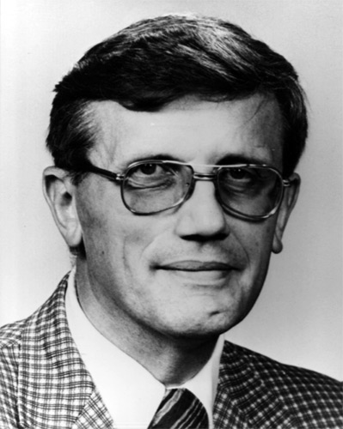
President/Director
Sayers “Bud” Miller University of Washington

Slide 21
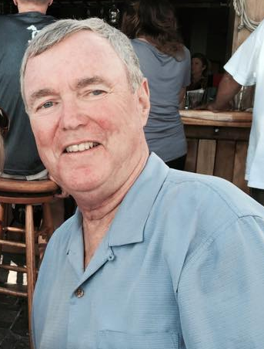
Vice President
Dick Melhart-Washington State University

Slide 22
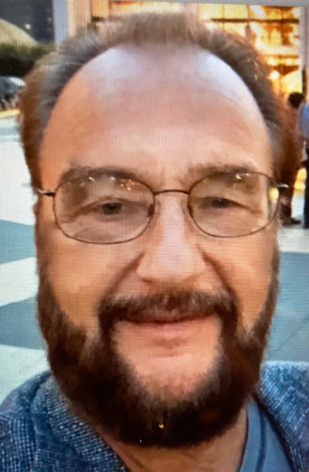
Secretary/Treasure
John Anderson, University of Washington

Slide 23
First Committee Chairs
Membership Gary Smith
Placement Larry Standifer
Public Relations Jimmy Whitesel
Constitution/Bylaws Wayne Rasmussen
First State Representatives
Idaho Bob Beeten, Idaho State University
Oregon Leo Marty, Portland Trailblazers
Montana Naseby Rhinehart, University of Montana
Washington Bud Miller-University of Washington
Alaska Vacant

Slide 24
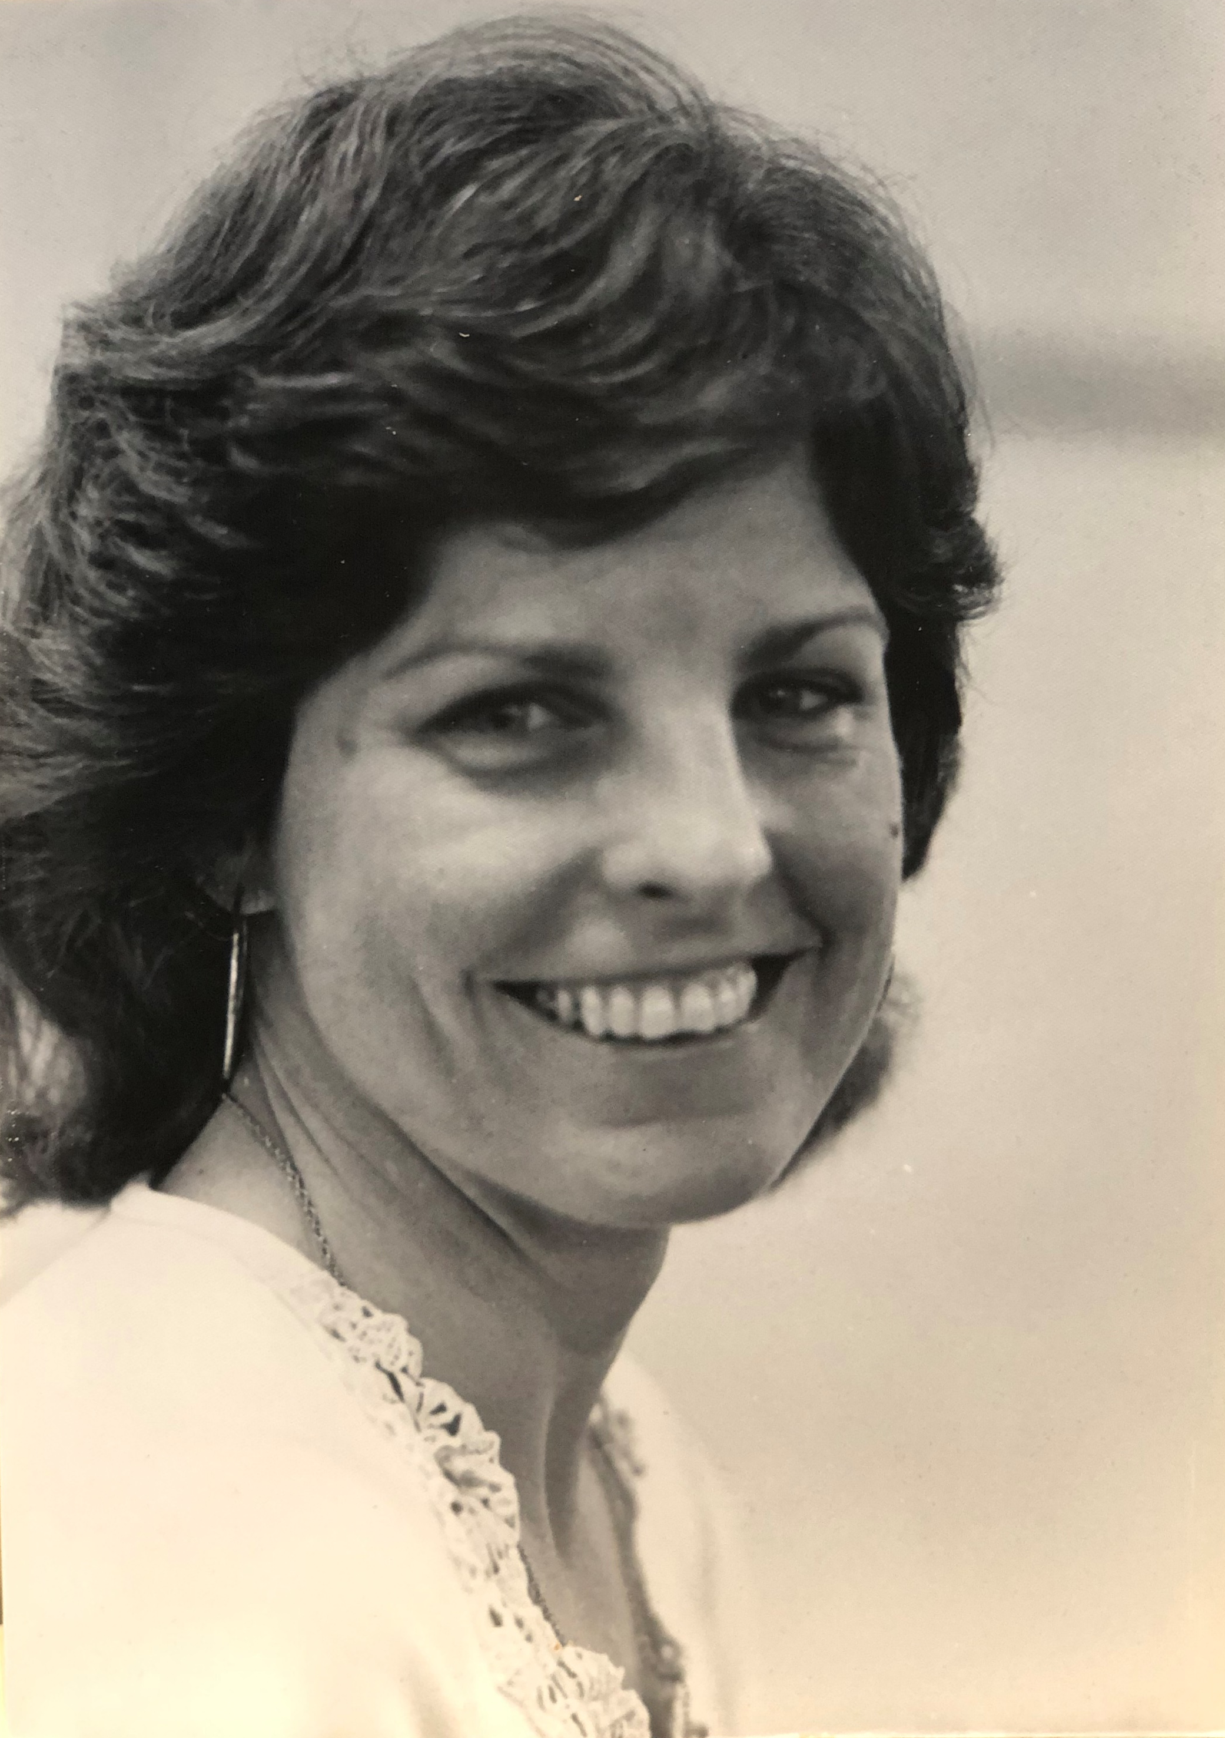
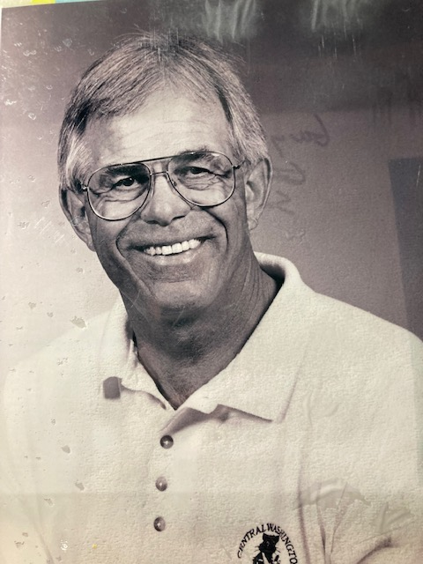
Sherry Kosek-Babagian Gary Smith

Slide 25
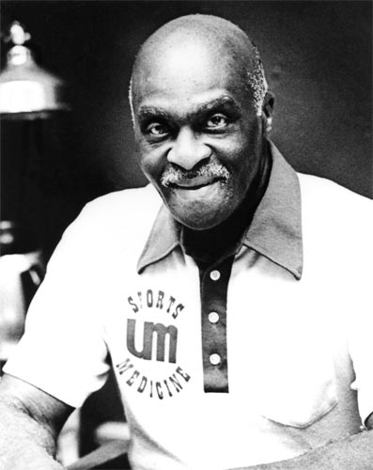
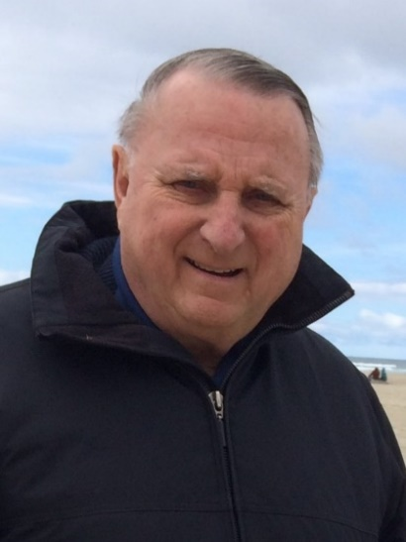
Naseby Rhinehart
University of Montana
Leo Marty
Portland Trailblazers/Portland State Univ.

Slide 26
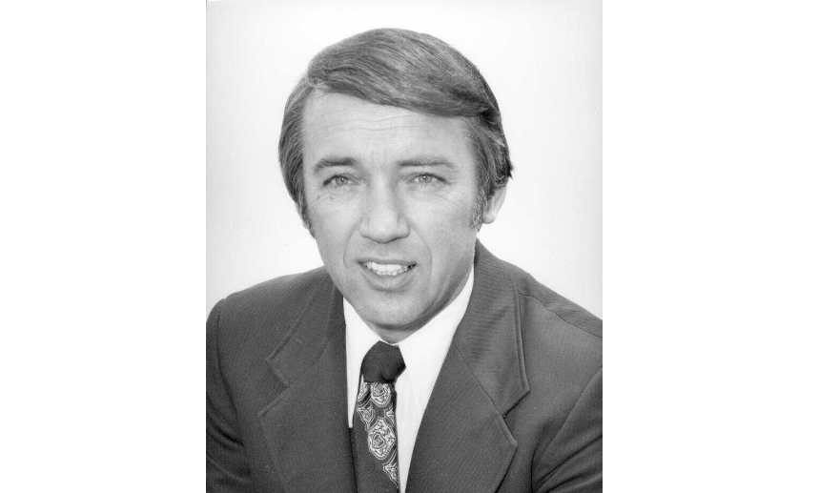
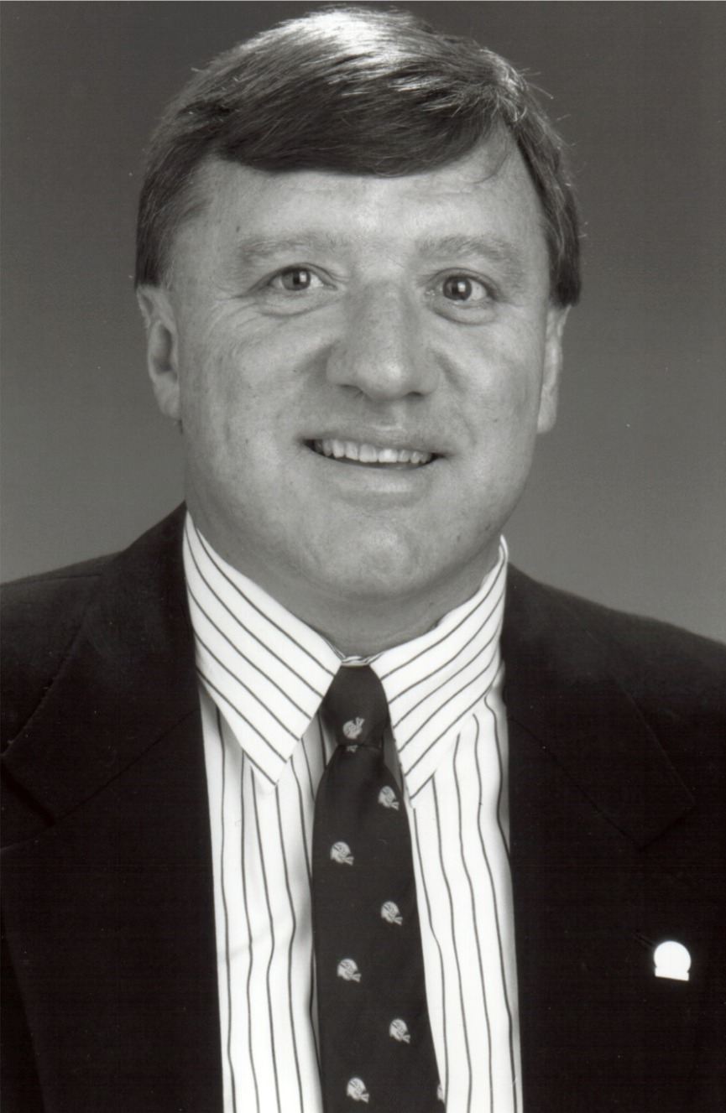
Larry Standifer Jim Whitesel

Slide 27
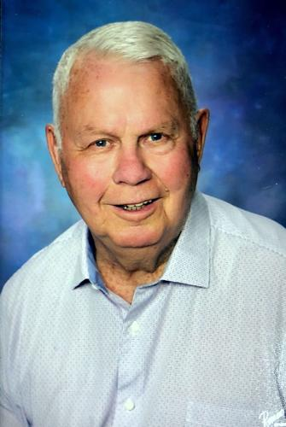
From 1973-1975, Dr. Keith Peterson of Seattle Sports Medicine hosted a weekend Symposia on the care and treatment of athletic injuries. District 10 held their business meetings during the lunch hour on Saturday. Bud Miller was the District Director and chaired the one hour meeting. The luncheon consisted of buckets of Kentucky Fried Chicken. Those known to be in attendance were such notables as Mark Smaha, Jim Whitesel, Chuck Karnop, Gary Craner, Gary Smith, Larry Standifer, Dick Melhart, Wayne Rasmussen, Ken Kladnik and others. Dr. Peterson passed away in 2018.

Slide 28
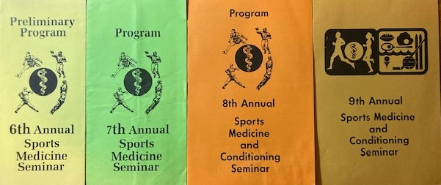

Slide 29
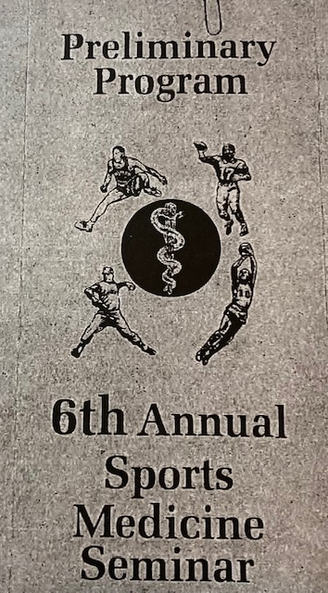
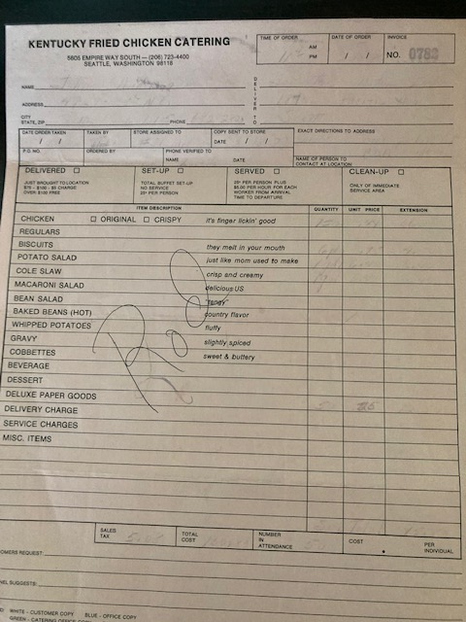

Slide 30

From 1976-79, our annual business meetings were held at Portland State University during a Sports Medicine Workshop hosted by Leo Marty. It was lead by then District Director, Larry Standifer from the University of Oregon. Similarly to what we did at Seattle Sports Medicine, we had a luncheon meeting.

Slide 31
The First Stand-Alone Meeting
March 29-30, 1980
Co-Chairs:
Mark Smaha-WSU Head Athletic Trainer
Ken Kladnik-Idaho Head Athletic Trainer
Inaugural Student Forum:
Tom Koto-University of Idaho student
Barrie Steele-WSU Student

Slide 33
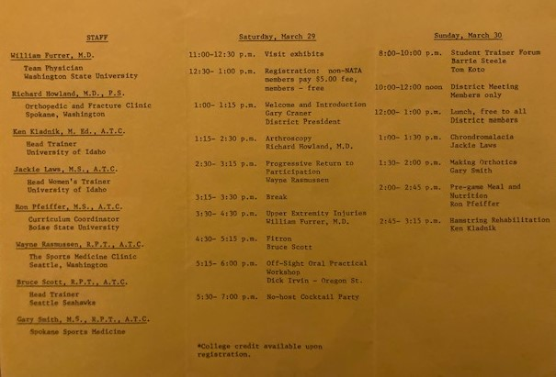

Slide 34
Notable people and events of the NWATA
Seattle hosted the NATA Convention in 1980. Jim Whitesel was the host Athletic Trainer and Naseby Rhinehart provided the keynote address.
Mark Smaha (WSU) served as the NATA President from 1988-1992, he was also awarded the Eve Becker-Doyle Leadership award in for Lifetime Service 2016.
Jim Whitesel (Seahawks) and staff were named NFL Athletic Staff of the year in 1993.
Rick Griffin (Seattle Mariners) and his staff were named the Major League Athletic Traning Staff of the year in 1999 and in 2013 the Martin-Monohan Award for the best medical staff in MLB.
Bob Grams (SPU) served as BOC President from 1988-1992 and Russ Cagle (Willamette University) served as BOC President from 1998-2000.

Slide 35
Mark Hoffman (Oregon State) served as the NATA Foundation President 2013-2015.
Ken Kladnik (Central Washington) served as the Chair of the NATA Foundation Scholarship committee from 2001-2008 and was recognized as the 2008 NATA Foundation Volunteer of the Year.
Ariko Iso (Oregon State) was hired as the first full time female athletic trainer in the NFL by the Pittsburgh Steelers in 2002.
Cari Wood becomes the first female District Director in 2013 and also was the first female inducted into the NWATA Hall of Fame in 2018.

Slide 36
NWATA Directors
        Sayers “Bud” Miller 1972-1973
        Dick Melhart 1973-1976
        Larry Standifer 1977-1979
        Gary Craner 1979-1982
        Mark Smaha 1982-1988
        Dennis Sealey 1988-1994
        Jim Whitesel 1994-1997
        Tom Koto 1997-2003
        Barrie Steele 2003-2009
        Russ Ricardson 2009-2013
        Cari Wood 2013-2017
        Tony Fitzpatrick 2017-2022
        Kasee Hildenbrand 2022-

Slide 37
NWATA Hall of Fame Members-inaugural class in 1999
    Francis “Packey” Boyle (Idaho)*
    Gary Craner (Boise State)*
    Gary Smith (Central Washington)
    James Whitesel (Seattle Seahawks)*
    Mark Smaha (Washington State)*
    Naseby Rhinehart (Montana)*
    Bob Peterson (Washington)
    Chuck Karnop (Montana State)
    Dean Adams (Oregon)
    Dennis Sealey (Washington)
    Phil Luckey (Idaho State)
* Also NATA HOF

Slide 38
NWATA Hall of Fame Members (cont.)
Ken Kladnik (Central Washington)* 2000
James “Zeke” Schuldt (Puget Sound) 2002
Dave Kendall (Western Montana) 2004
Tom Koto (St. Luke’s/Boise)* 2004
  Barrie Steele (Idaho)* 2010
Jim Richards (Northwest University) 2010
Tony Fitzpatrick (Timberline H.S) 2014
Russ Richardson (Western Montana)* 2015
Marty Matney (Work-Fit/Boeing)* 2016
Cari Wood (Redmond, OR H.S) 2018
Dani Moffit (Idaho State University) 2022
* Also NATA HOF

Slide 39

Alaska Athletic Trainers’ Association-2009

Slide 40

Idaho Athletic Trainers’ Association-1985

Slide 41

Montana Athletic Trainers’ Association-1983

Slide 42

Oregon Athletic Trainers’ Society-1983

Slide 43

Washington Athletic Trainer’s Association-1983

Slide 44
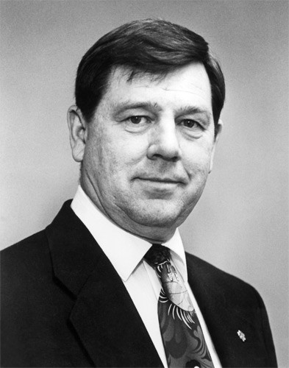
50th Anniversary Panel
Gary Craner

Slide 45
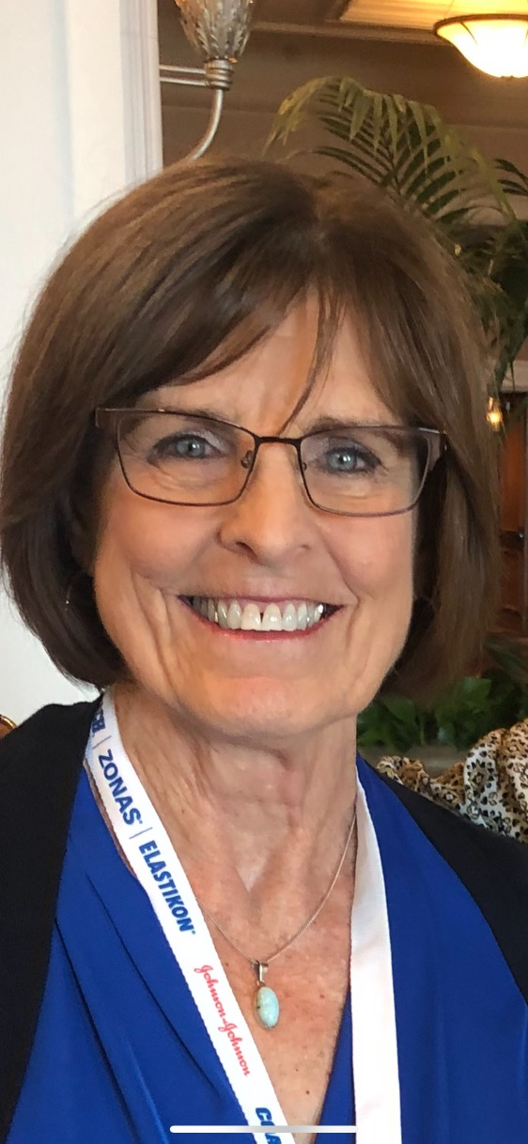
Sherry Kosek-Babagian

Slide 46
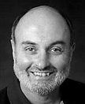
James “Zeke” Schuldt

Slide 47
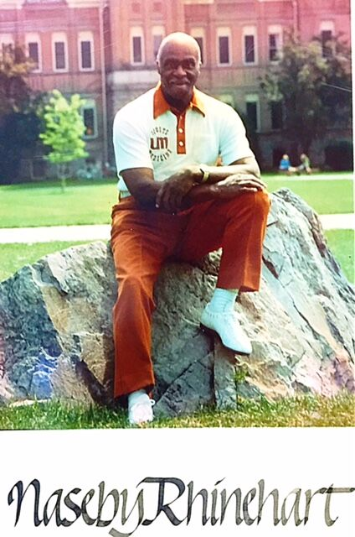
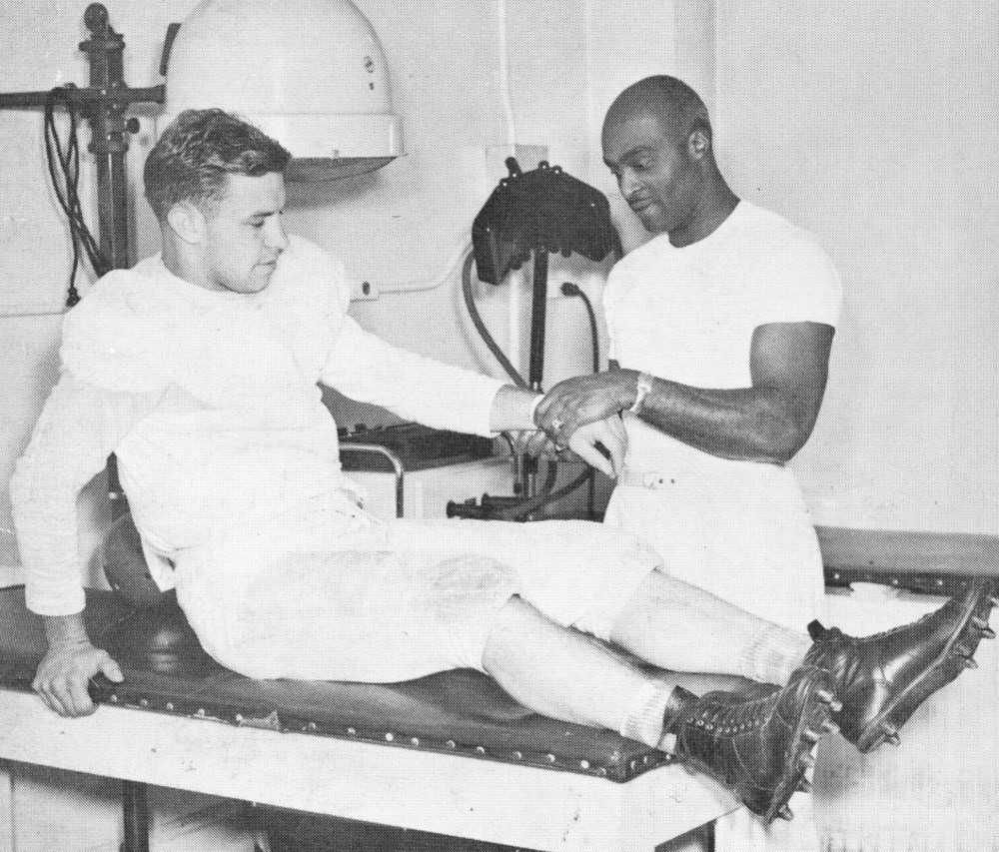
Naseby Rhinehart (1911-1991)

Slide 48
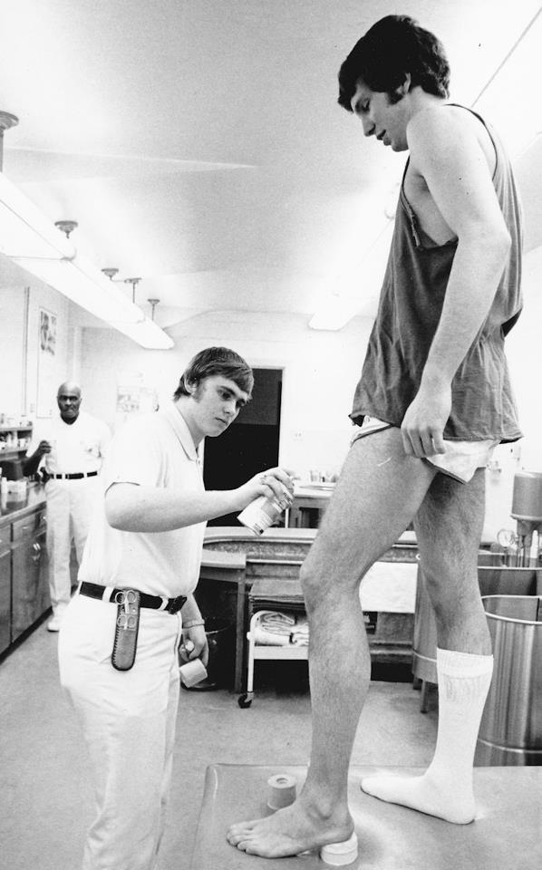
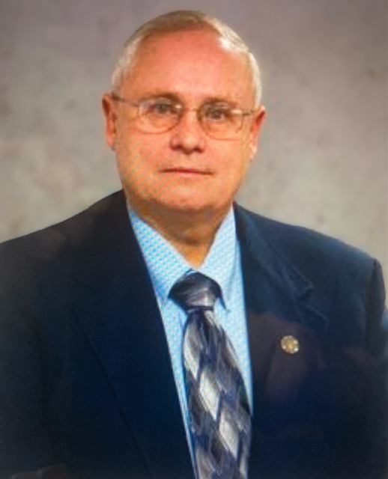
Dennis Murphy Dennis under Naseby’s watchful eye

